Slide 1
U.S. Cities – Where to Live

Slide 2
Deciding Where to Live in the U.S.
Since 2010 roughly 35.5 million Americans on average moved each year from one address to another
Determining which city to live is a complex one
Many factors can contribute to the decision of which city to move, a few among them are cost of living, employment opportunities, education levels, available activities, diversity, and city size
How should you start the process in choosing potential candidate cities? Let’s start with machine learning!

Slide 3
Data
We can use machine learning to cluster U.S. cities into different groups, each group with a different set of attributes
We narrow down the number of cities to examine by selecting only U.S. cities with population greater than 100,000 people
We leverage U.S. Census Bureau data which contains city level data on the following categories: population characteristics, housing, education, income, and geography
We leverage Foursquare venue data to approximate the available activities a city has.

Slide 4

Exploring the Data – City Population
There are 314 cities with population greater than 100,000
The states with the most cities represented in our model are the following:
Cities experiencing the greatest population growth are found in Idaho, North Dakota, South Dakota, and Georgia

Slide 5
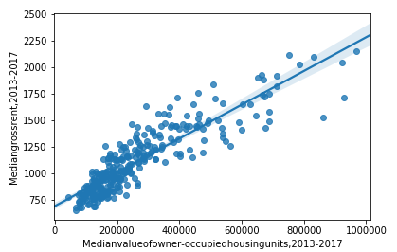
Exploring the Data – Cost of Living
Cost of living can be estimated by the housing values and/or rental prices.
We find that there is a strong correlation between housing values and rental prices (r = 0.890). We will therefore use only one of these measures, gross rent, in our model of city clusters

Slide 6
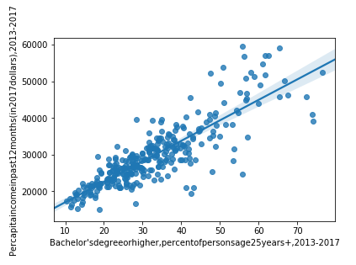
Exploring the Data – Education and Income
Education levels and per capita income are both important considerations in the decision of choosing a city.
We find that there is a strong correlation between education levels and per capita income (r = 0.845).
In the graph to the right, we see some fanning out of the data as percent educated increases, so we will use both measures in our model of city clusters

Slide 7
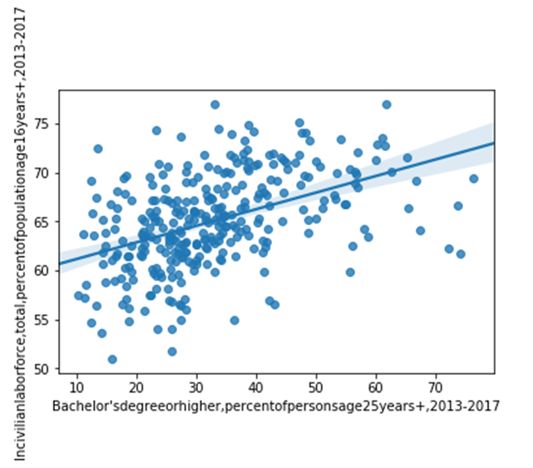
Exploring the Data – Education and Employment
We find that there is a weak correlation between education levels and employment levels (r = 0.454)

Slide 8

Exploring the Data – Diversity
We quantify population diversity using Simpson’s diversity index. For each city, we calculate the sum of the frequency of each population group Pi multiplied by the rareness of the group 1 - Pi.
Of the top ten cities for diversity, 7 are in California. We see represented our most populous city of New York City in 8th. The most diverse city according to Simpson’s diversity index is Vallejo, California.
The average diversity index for the US cities with population greater than 100k is .579.
The states with the least diverse cities of 100k+ are Idaho, Montana, and North Dakota

Slide 9
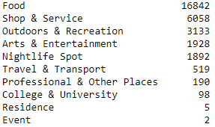
Exploring the Data – Activities
To approximate the number of activities a city has to offer, we use the Foursquare Explore endpoint to get the top 100 recommended venues for each city in our list and characterize each venue by its high-level category, the counts of which are in the chart to the right.
Of all the venue categories, we see the strongest correlations between population and Outdoors & Recreation (r = .551), Food (r = -.504), and Arts & Entertainment (r = .407).

Slide 10
K-Means Clustering
We decided to use k-means clustering machine learning algorithm to divide our cities into different groups based on the features included in the model.
Our model has the following feature set in the table to the right. In the first column, we have the venue frequencies from the Foursquare data. In the second column, the Census Bureau Data.
Venue Frequencies | Census Bureau Data
Arts & Entertainment | Population
College & University | Population Percent Change
Event | Median Gross Rent
Food | % with bachelor’s degree or higher
Nightlife Spot | % Employed
Outdoors & Recreation | Per capita income
Professional & Other Places | Diversity Index
Residence | Land area (square miles)
Shop & Service
Travel & Transport

Slide 11
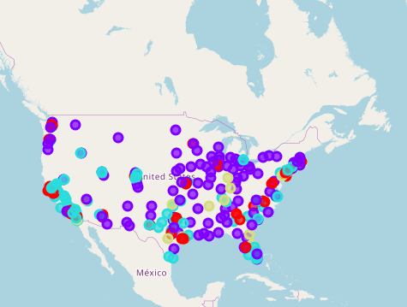
Results
We decided to cluster the cities into 4 groups. We summarize the cluster types below:
Cluster 0 - Medium Population; Some Activities; High growth; High rent; High education; High income (RED)
Cluster 1 - Medium Population; Some Activities; Lower rent; Less diversity (PURPLE)
Cluster 2 - Lower Population; Less Activities; Less educated; Higher rent with lower income (BLUE)
Cluster 3 - High Population; Lots of Activities; Greater diversity; reasonable rent; larger land area (YELLOW)

Slide 12
Discussion
Cluster 2 cities appear to be least attractive
Next is Cluster 1: lower rent with similar income levels as Cluster 2, and on average more activities. Cluster 1 cities are predominantly in the Midwest and Southern states
Clusters 0 and 3 both have attractive features, but it’s difficult to determine which one is necessarily better.
Cluster 0 is very attractive in that these cities are on average experiencing greater population growth, with higher per capita incomes and a more educated population. Cluster 0 is facing higher rents -> higher cost of living
Cluster 3 are urban cities that offer the most activities for their residents and have more diversity with lower rents, but they also have lower incomes

Slide 13
Conclusion
Project was able to group cities into different clusters, with the intention of highlighting potential cities for stakeholders to move and live
The final decision on best city to move to is a very personal and complex one, and stakeholders will end up considering many additional factors not modeled in this project. Others include:
state tax landscape, crime rates, proximity to family, climate, education, healthcare, and industry specific employment opportunities, among others
We hope that the analysis performed thus far will provide stakeholders a place to start in exploring urban U.S. cities

